Slide 1


Slide 2


Slide 3

Name: Payal Kangsabanik
College Name: Guru Nanak Institute of Technology
Department: Master of Computer Applications
Semester: 3rd Semester

Slide 4
Acknowledgement
I am sincerely thankful to my mentor, Mr. Satyaki Das, for his unwavering support, insightful guidance, and constant encouragement throughout the course of this project. I also extend my heartfelt gratitude to Classroom Tech for offering the platform, resources, and assistance that played a vital role in bringing this project to completion.

Slide 5
TABLE OF CONTENTS:
1️⃣ Title Slide : 2️⃣ Acknowledgement : 3️⃣ Table of Contents : 4️⃣ Objective / Problem Statement : 5️⃣ Dataset Overview : 6️⃣ Tools Used : 7️⃣ Methodology : 8️⃣ Detailed Slide for Each Visualization : 9️⃣ Key Findings : 🔟 Conclusion : 1️⃣1️⃣ References : 1️⃣2️⃣ Github Repository Link : 1️⃣3️⃣ Thank You! :

Slide 6

Objective / Problem Statement:
1) Goal of the Project:
The objective of the "Blinkit Sales Data Analysis" project was to examine sales data to identify key trends in customer behavior, top-selling products, and delivery patterns. The goal was to transform raw data into actionable insights that support better business decisions and improve operational efficiency in Blinkit's quick-commerce model.
2) Questions Addressed:
1. Create a bar chart showing the number of orders placed per customer.
2. How do you calculate the total number of orders placed in a given month?
3. Create a pie chart showing the distribution of feedback categories from Table 1.
4. Create a table visualization showing customer details (customer_id, name, email) from Table 2.
5. How can you filter orders based on delivery status (on-time, delayed) from Table 3?
6. Create a column chart showing stock received over time for different products (Table 4 & Table 5).
7. How do you calculate the percentage of damaged stock per product?
8.Show a table with all campaigns (campaign_id, campaign_name, spend, revenue_generated) from Table 6.

Slide 7

9. Create a KPI visual to display the average order value (avg_order_value) from Table 2.
10. How do you calculate the total revenue generated from all campaigns in Table 6?
11. Create a stacked bar chart to compare order quantity per product (Table 7).
12. How do you calculate the total sales revenue per product?
13. Create a measure to calculate the total delivery time (actual_time - promised_time) in Table 3.
14. How do you visualize customer segments (Table 2) using a pie chart?
15. Create a heatmap showing the frequency of orders per pincode (Table 2).
16. How do you create a calculated column for delivery delays (actual_delivery_time - promised_delivery_time)?
17. Create a measure to calculate the Return on Ad Spend (ROAS) using (revenue_generated / spend) from Table 6.
18. Show a scatter plot of distance vs. delivery time to analyze delivery efficiency (Table 3).
19. Create a measure to calculate customer retention rate using total_orders from Table 2.
20. How do you create a forecast for future stock levels based on historical stock received data (Table 4 & Table 5)?

Slide 8
21. Create a report to identify the top 5 best-selling products based on quantity ordered (Table 7).
22. Create a measure to calculate gross profit using margin_percentage from Table 9.
23. How do you build a dashboard to track order trends across different categories (Table 9)?
24. Build a time-series analysis of daily order counts using order_date from Table 8.
25. How do you use DAX to find the most frequently ordered product?
26. Create a matrix visualization to show order quantity per product category (Table 9).
27. How do you calculate customer lifetime value using avg_order_value and total_orders (Table 2)?
28. How do you create a funnel chart to track the campaign conversion process (Table 6)?
29. Create a dynamic slicer for filtering orders by delivery status (on-time vs delayed).
30. Create a report to track customer orders by store_id (Table 8).
31. Build a map visualization showing order density per area (Table 2).
32. Use a measure to calculate product-wise discount percentages using price and MRP (Table 9).
33. How do you use decomposition tree visualization to analyze product sales?
34. Create a Power BI report that links emoji-based ratings (Table 11) to product categories (Table 9).

Slide 9
DATASET OVERVIEW:
Dataset Name: Blinkit Sales Data
Source: Kaggle
Description: A comprehensive dataset containing various aspects of Blinkit's operations, including sales, customer information, product details, campaign performance, delivery metrics, and feedback.
Key Tables and Columns Used for Analysis:
1️⃣Overall Metrics (KPIs):
Total Revenue, Total Customer Lifetime Value, Average Order Value, Total Campaign Revenue
2️⃣Customer Details Table:
Rows: 18 (sample shown)
Columns: 3 (customer_id, customer_name, email)
Purpose: Customer identification and contact information.
3️⃣Customer Lifetime Value Table:
Rows: 14 (sample shown)
Columns: 4 (customer_id, customer_name, Sum of avg_order_value,
Total Customer Lifetime Value)
Purpose: Analyzing customer value and spending patterns.

Slide 10
4️⃣Order Quantity Per Product Category Table:
Rows: 9
Columns: 2 (category, Count of quantity)
Purpose: Understanding product category performance by volume.
5️⃣All Campaigns Table:
Rows: 14 (sample shown)
Columns: 4 (campaign_id, campaign_name, Sum of spend, Sum of revenue_generated)
Purpose: Evaluating marketing campaign effectiveness.
6️⃣Feedback Details Table:
Rows: 10 (sample shown)
Columns: 5 (feedback_id, order_id, sentiment, feedback_category, rating)
Purpose: Analyzing customer sentiment and feedback categories.
7️⃣Total Sales Revenue per Product Table:
Rows: 10
Columns: 2 (product_name, Total Sales Revenue per Product)
Purpose: Tracking revenue generated by each product.

Slide 11
8️⃣Customers Orders by Store ID Table:
Rows: 11 (sample shown)
Columns: 3 (store_id, order_id, Sum of order_total)
Purpose: Understanding order distribution across different stores.
9️⃣Product Category Ratings Table:
Rows: 4 (sample shown)
Columns: 3 (category, Average Customer Rating Emoji, Rating)
Purpose: Evaluating customer satisfaction with product categories.

Slide 12


Tools Used:
1️⃣Power BI:
Utilized for data cleaning, transformation, and modeling.
Developed interactive dashboards and reports for insightful data visualization.
Enabled dynamic filtering and drill-down capabilities for deeper analysis.
2️⃣GitHub for Repository Management:
Used for version control of project files, including Power BI reports and documentation.
Facilitated collaboration and ensured tracking of all changes made during the analysis process.

Slide 13
Methodology:
Data Acquisition:
Obtained the Blinkit Sales Data from Kaggle.
Data Cleaning & Transformation:
Missing Values Handling: Identified and addressed missing data points, employing appropriate strategies (e.g., imputation) to maintain data quality.
Outlier Removal: Analyzed data for outliers that could skew results and applied techniques to mitigate their impact, ensuring robust analysis.
Visualization Creation:
Key Performance Indicators (KPIs): Designed prominent cards to display critical business metrics like Total Revenue, Customer Lifetime Value, and Average Order Value for immediate insights.
Distribution Analysis: Utilized pie charts and bar charts to illustrate the distribution of customer segments and the concentration of orders across different pincodes.

Slide 14
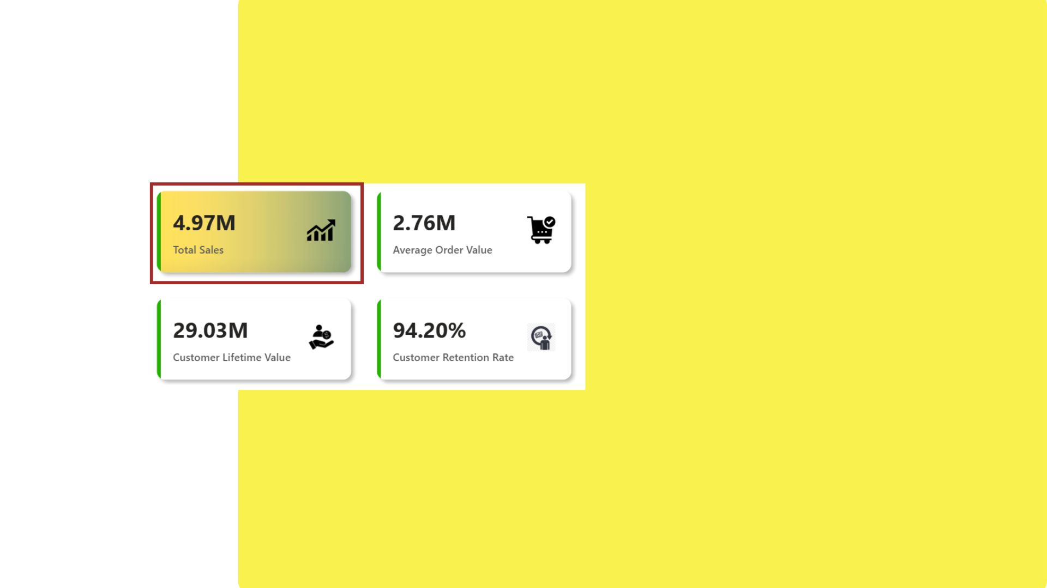
1. TOTAL SALES OVERVIEW
Purpose:
To present the overall revenue generated from customer purchases.
Acts as a key performance indicator (KPI) to track business growth and sales success.
Insights:
The total sales amount stands at 4.97 million.
This figure reflects strong revenue performance and can guide strategic planning.
The card visualization offers a quick snapshot of business health, ideal for dashboards and executive reviews.

Slide 15
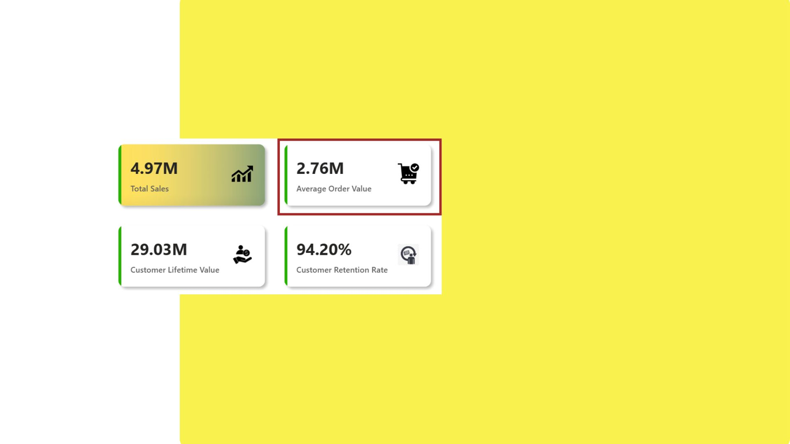

2. AVERAGE ORDER VALUE
Purpose:
To measure the average amount spent per order, providing insight into purchasing behavior.
Insights:
The Average Order Value is ₹2.76M, indicating that each transaction contributes significantly to total revenue.
A high AOV suggests effective upselling, bundling, or high-value product focus.
Useful for evaluating pricing strategy and campaign effectiveness

Slide 16
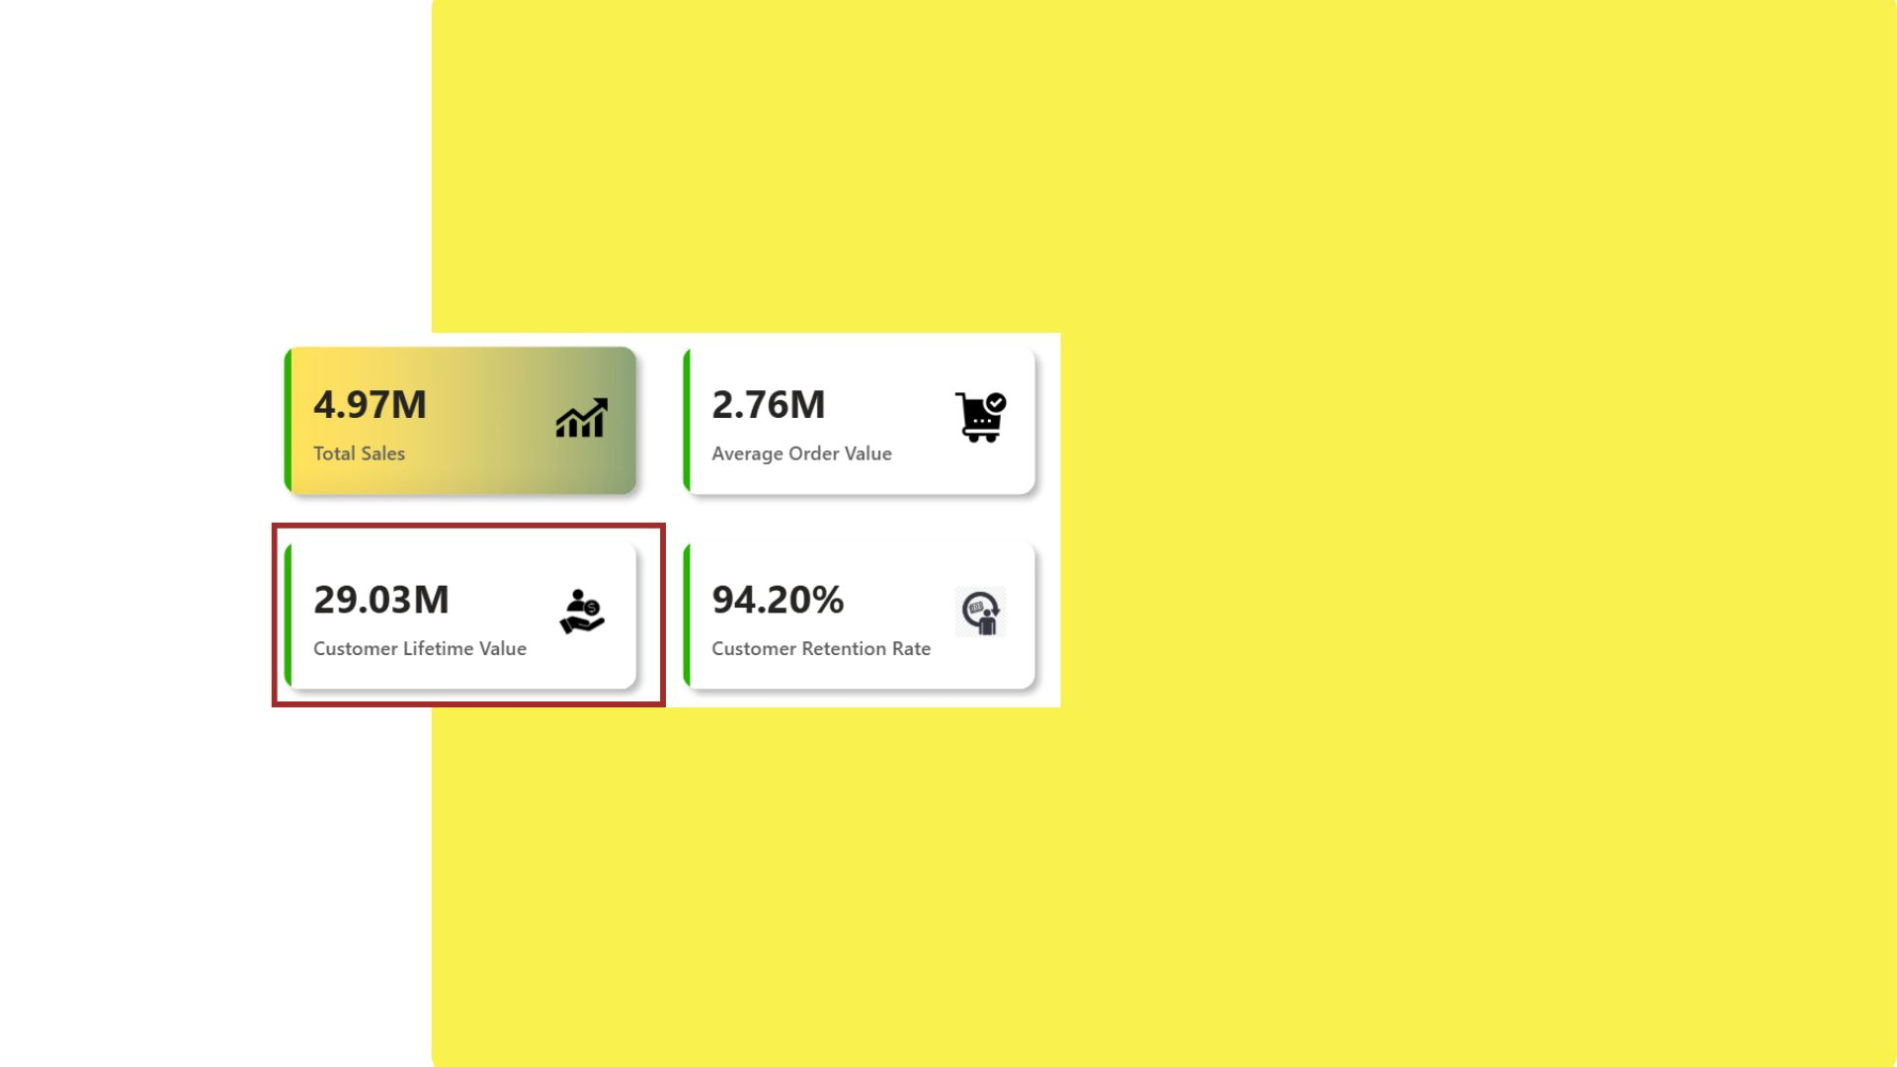
3. CUSTOMER LIFETIME VALUE(CLV)
Purpose:
To estimate the total revenue a business can expect from a single customer over the duration of their relationship.
Insights:
The CLV stands at ₹29.03M, showing strong long-term customer engagement.
High CLV suggests good customer experience, retention, and repeat purchase behavior.
Essential for planning marketing investment and loyalty programs.

Slide 17
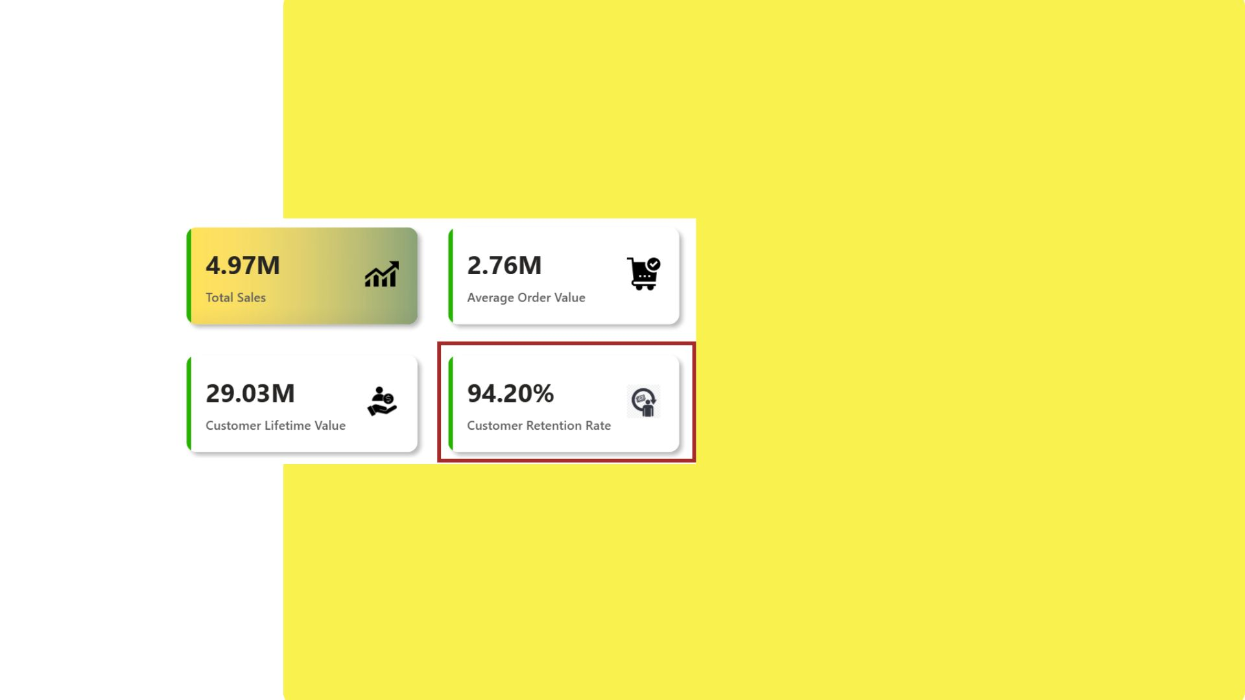
4. CUSTOMER RETENTION RATE
Purpose:
To assess how well the business retains its customers over time.
Insights:
A retention rate of 94.20% is excellent, indicating that most customers return after their first purchase.
High retention lowers customer acquisition costs and supports sustainable growth.
Suggests effective customer satisfaction and after-sales service.

Slide 18

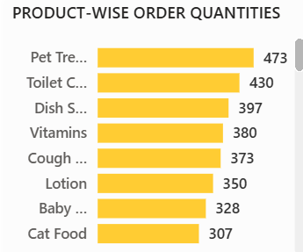
5.PRODUCT-WISE ORDER QUANTITIES
Purpose:
This chart helps identify which products are being ordered the most by customers.
It assists in making data-driven inventory and marketing decisions by highlighting demand patterns.
Insights:
This distribution indicates that pet and hygiene-related items are in higher demand, which can guide stock planning and promotional focus.
The visualization is created using a bar chart, where:
Y-axis: Product names (product_name)
X-axis: Total quantities ordered (Sum of quantity)

Slide 19

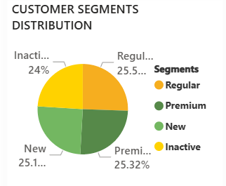
6. CUSTOMER SEGMENTS DISTRIBUTION
Purpose:
To analyze the distribution of customers across various segments
Helps in understanding customer behavior and planning targeted marketing strategies
Insights:
The customer base is almost evenly divided among Regular (25.5%), Premium (25.3%), and New (25.1%) segments
Inactive customers account for 24%, which is a significant portion
A balanced spread shows good customer diversity, but the inactive group highlights an opportunity for re-engagement campaigns.

Slide 20
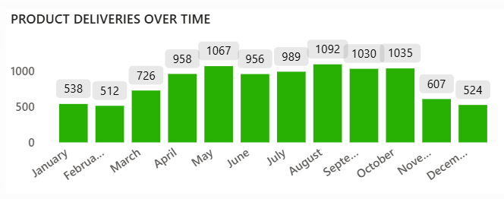
7. PRODUCT DELIVERIES OVER TIME
Purpose:
To track monthly product deliveries based on the actual delivery time
Helps evaluate logistics efficiency and demand fulfillment trends over the year
Insights:
Highest deliveries in September (1092)
Strong delivery volume from April (958) to October (1035)
Lowest deliveries in February (512) and December (524)
Sharp increase in Q2, followed by a year-end decline

Slide 21
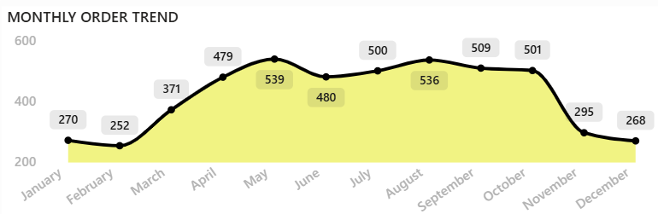
8. MONTHLY ORDER TREND
Purpose:
Analyze the number of orders placed each month
Identify peak and low order periods
Insights:
May recorded the highest orders (539)
February had the lowest (252)
Strong growth from March to May, steady till October
Sharp drop in orders during November and December

Slide 22
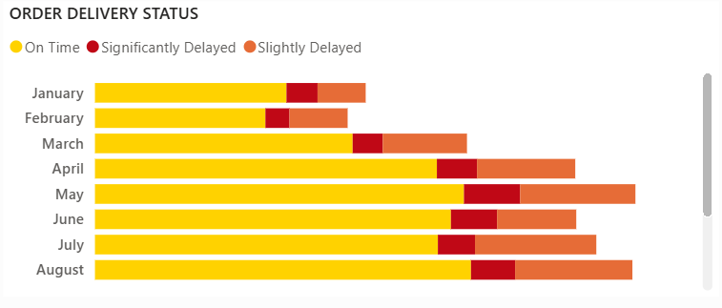
9. ORDER DELIVERY STATUS
Purpose:
Analyze monthly order delivery performance
Categorize deliveries as On Time, Slightly Delayed, or Significantly Delayed
Insights:
On-time deliveries were high from January to March
Delays started increasing from April onwards
August recorded the highest delay rate.

Slide 23
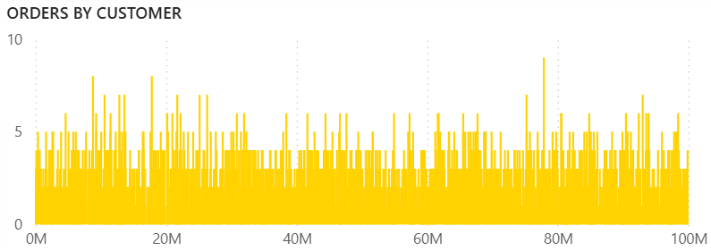
10. ORDER BY CUSTOMER
Purpose:
This chart visualizes the distribution of orders across all customers.
It aims to uncover overall customer engagement by displaying how frequently different customers place orders.
Insights:
Most customers placed 3–6 orders, with a few placing up to 9–10.
The chart shows a long-tail pattern, where only a few customers are highly active.
Useful for spotting loyal buyers and planning targeted promotions.

Slide 24
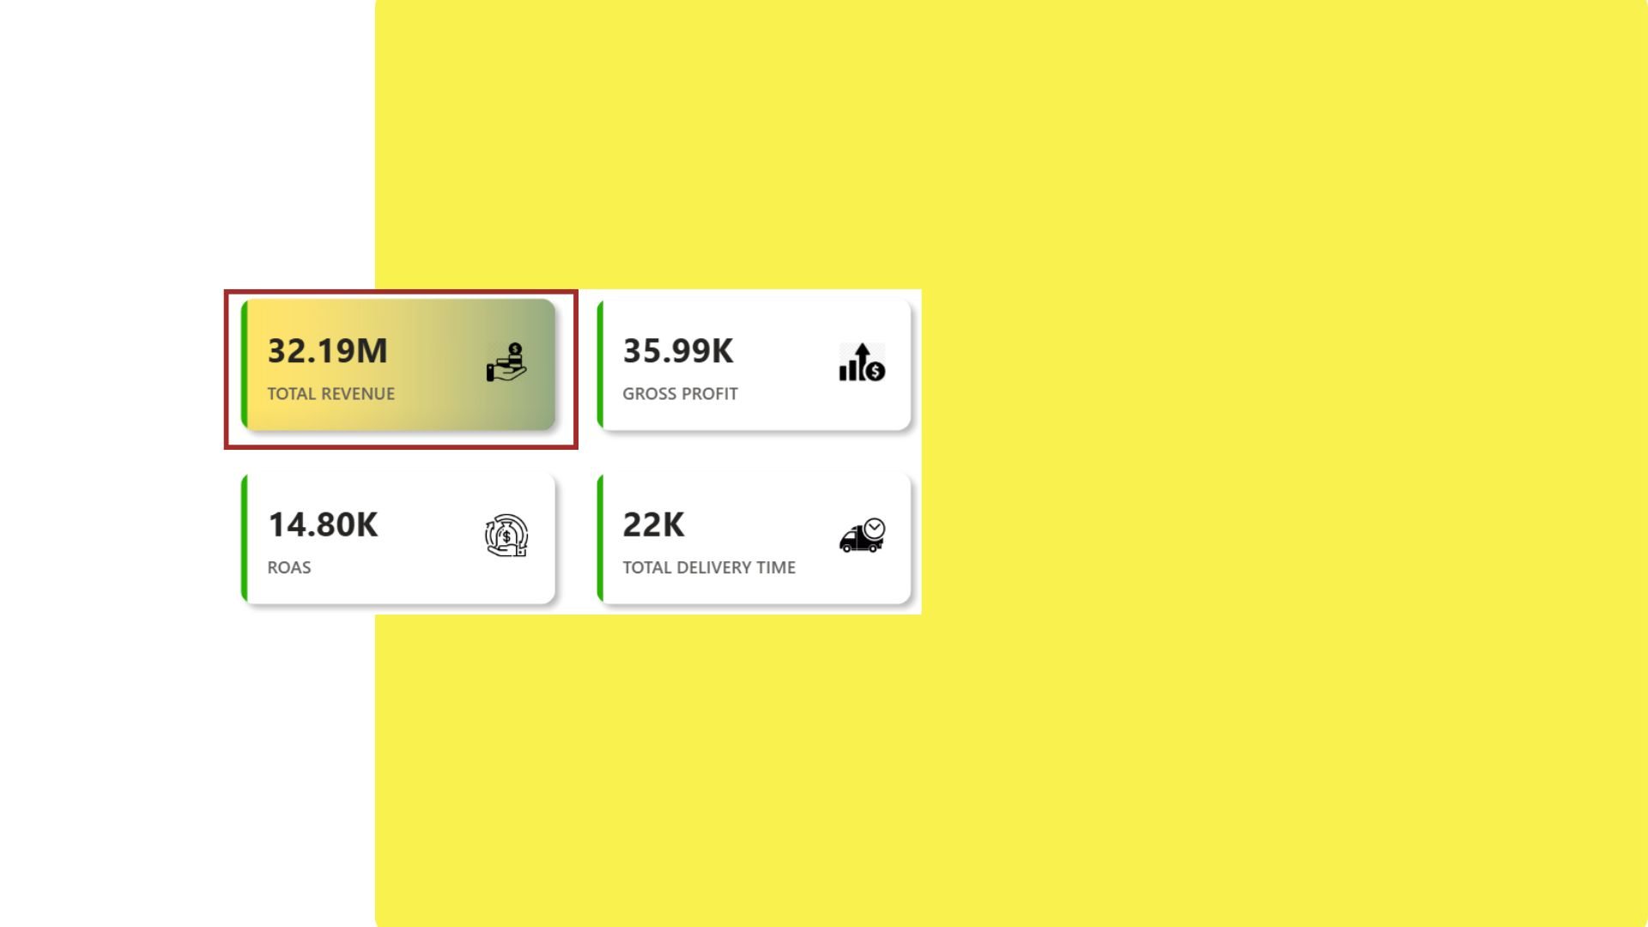
11. TOTAL REVENUE
Purpose:
To present the total income generated from all sales activities during the reporting period. It reflects the overall business performance and revenue-generating capability.
Insights:
The company achieved a total revenue of ₹32.19 million, indicating strong sales performance
This figure reflects the effectiveness of marketing, demand generation, and order fulfillment strategies.
It serves as a critical indicator for financial growth and helps in evaluating future revenue goals.

Slide 25
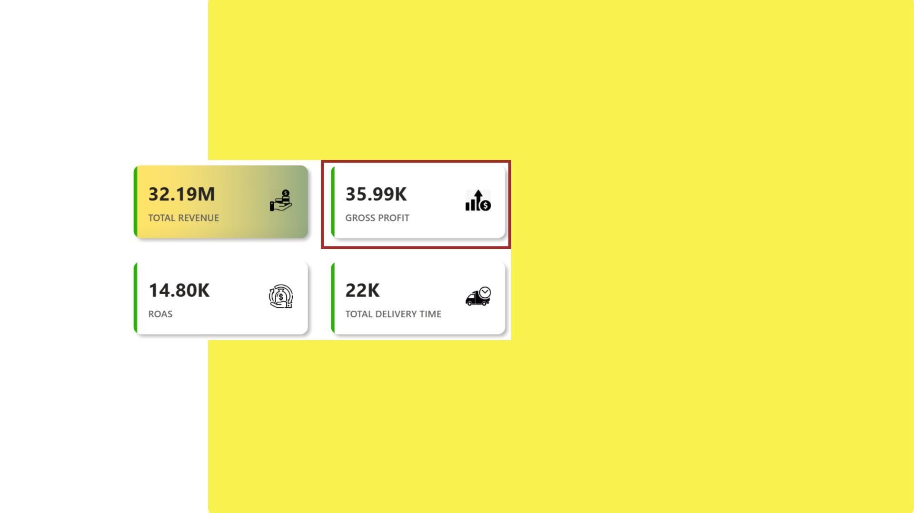
12. GROSS PROFIT
Purpose:
To measure the business's profitability after subtracting the cost of goods sold (COGS) from total revenue. It helps assess operational efficiency and pricing strategy.
Insights:
The gross profit is ₹35.99K, showing what remains after direct costs are deducted.
This metric is vital for evaluating business sustainability and long-term growth potential.
While revenue is strong, the lower profit margin suggests a need to explore ways to optimize production or sourcing costs.

Slide 26
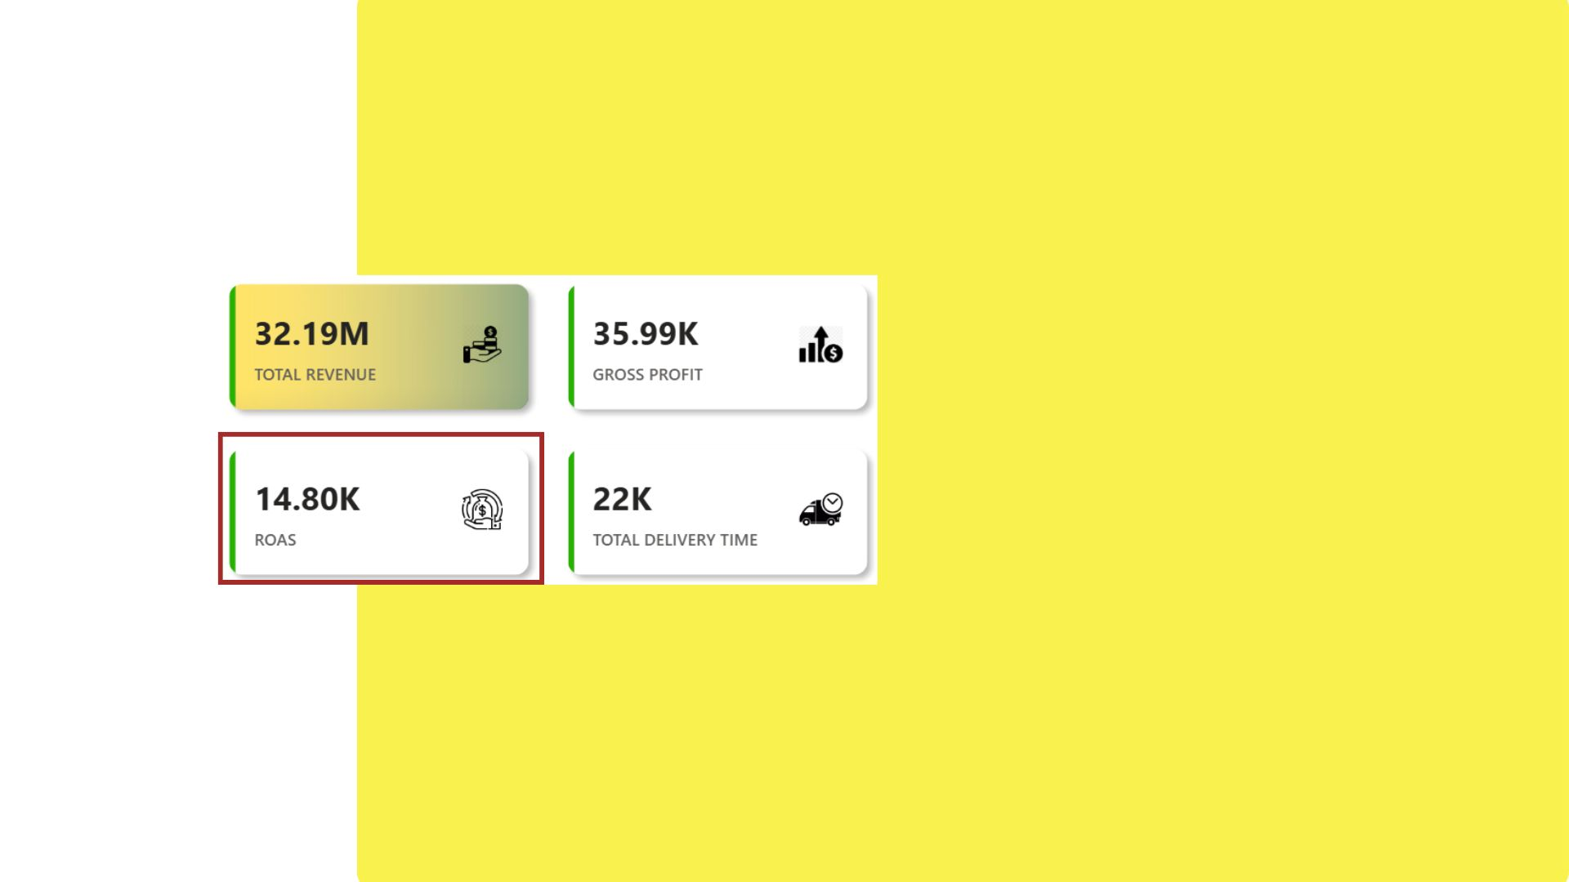
13. ROAS (Return on Ad Spend)
Purpose:
To evaluate the return on investment (ROI) from advertising expenses. It tells how much revenue is generated for every unit spent on ads.
Insights:
The ROAS stands at ₹14.80K, indicating that advertising efforts are contributing positively to revenue generation.
A higher ROAS suggests efficient targeting and campaign performance.
Continuous monitoring is recommended to ensure ad spend remains cost-effective across all channels.

Slide 27
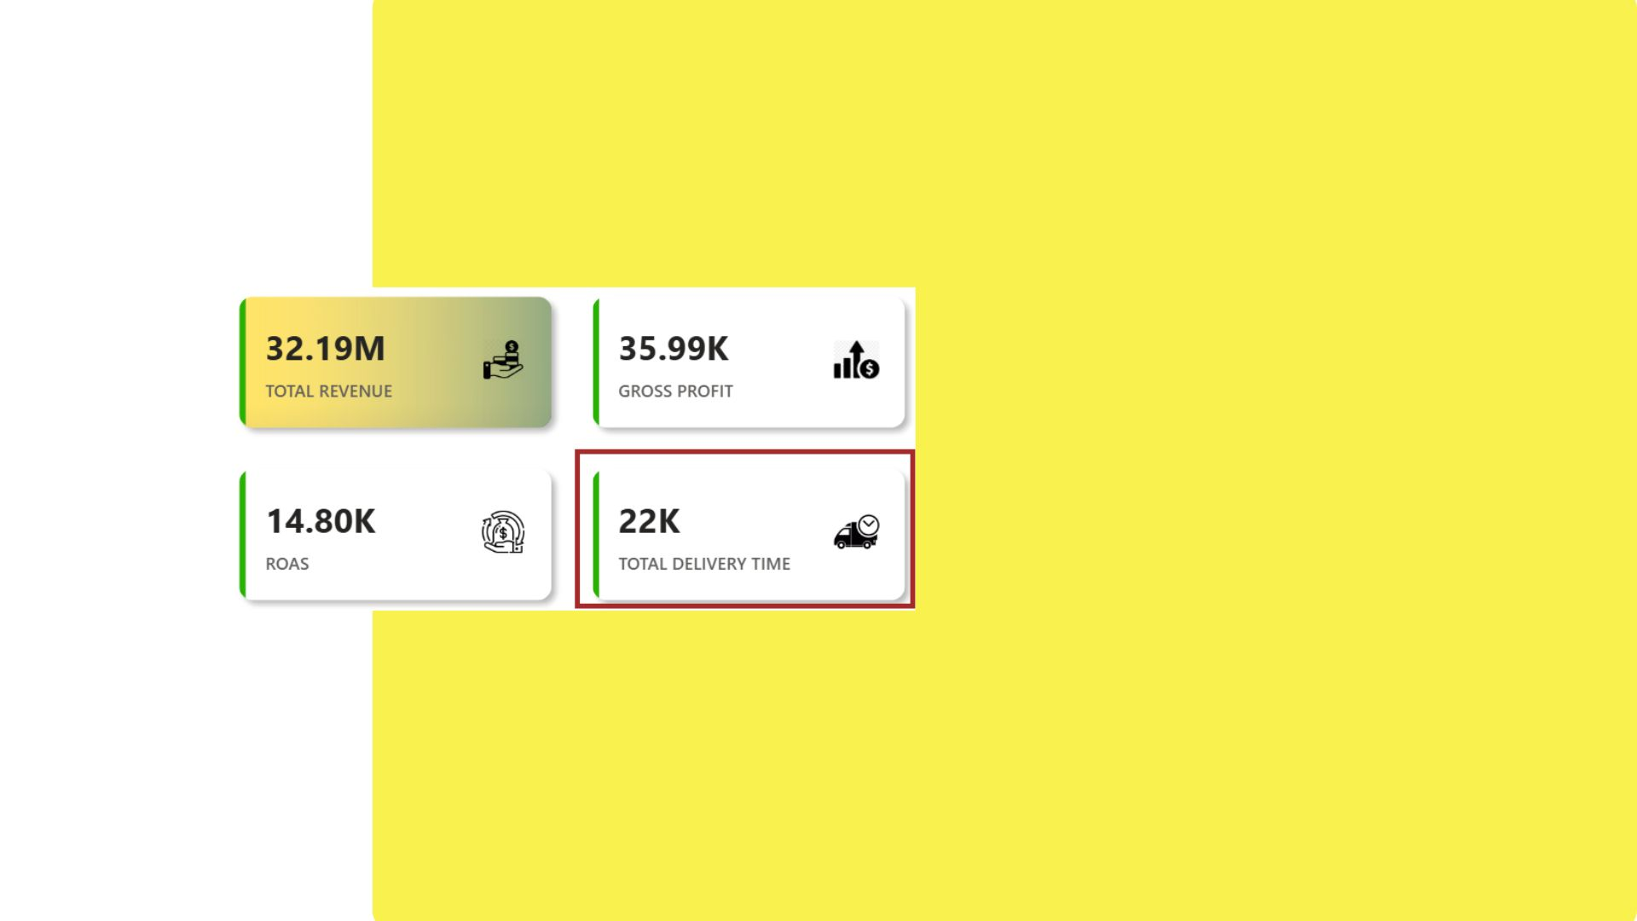
14. TOTAL DELIVERY TIME
Purpose:
To measure the total amount of time spent delivering products to customers. This helps assess supply chain efficiency and customer experience.
Insights:
The total delivery time recorded is 22K units (likely in hours or minutes).
This metric provides insights into logistics operations and highlights areas where delivery time could be optimized.
Reducing delivery time can lead to higher customer satisfaction and increased repeat orders.

Slide 28
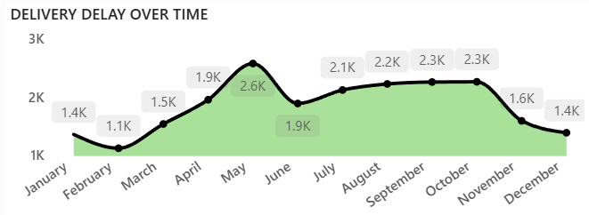
15. DELIVERY DELAY OVER TIME
Purpose:
To analyze the total delivery delay (in minutes) over the months in order to:
Identify patterns and seasonal trends
Detect peak delay periods.
Insights:
May experienced the highest delay (2.6K minutes)
February had the lowest delay (1.1K minutes)
Delay levels were consistently high from July to October
December showed improvement, with delay dropping back to January levels

Slide 29
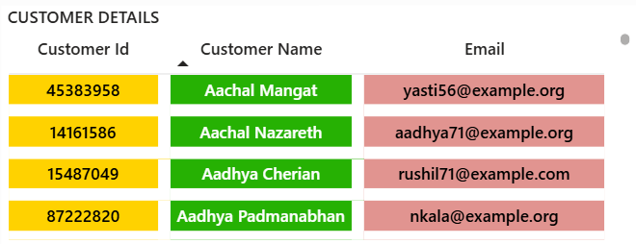
16. CUSTOMER DETAILS REPORT
Purpose:
To display key customer data—ID, Name, and Email—for quick access and reference.
Insights:
Customer IDs are highlighted in yellow for visibility.
Names are in green for easy recognition.
Emails use a red background to separate contact info.

Slide 30
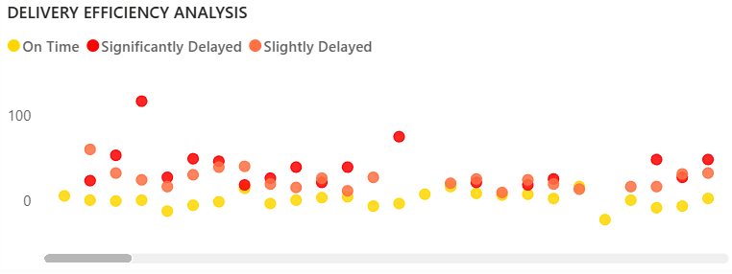
17. DELIVERY EFFICIENCY ANALYSIS
Purpose:
To analyze how delivery time varies with distance and identify delay patterns.
Insights:
Data is grouped by delivery status (On Time, Slightly Delayed, Significantly Delayed).
Significant delays are scattered across both short and long distances.
On-time deliveries mostly have lower delay times, regardless of distance.

Slide 31
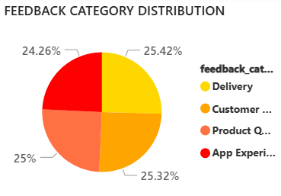
18. FEEDBACK CATEGORY DISTRIBUTION
Purpose:
To understand how customer feedback is spread across key areas.
Insights:
Feedback is almost evenly split across categories.
Delivery (25.42%) received the highest share.
App Experience (24.26%) received the least, but only slightly lower.
Suggests that customer concerns are distributed, with no dominant issue.

Slide 32
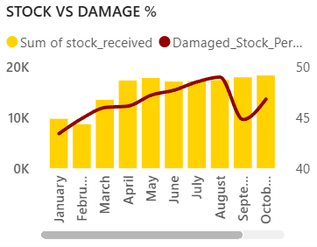
19. STOCK VS DAMAGE %
Purpose:
To compare total stock received with the percentage of damaged stock over time.
Insights:
Stock received peaked between May to August.
Damage percentage also increased during this period, peaking in August.
September saw a sharp drop in damages despite high stock levels.
Indicates a potential improvement in stock handling from September onwards.

Slide 33
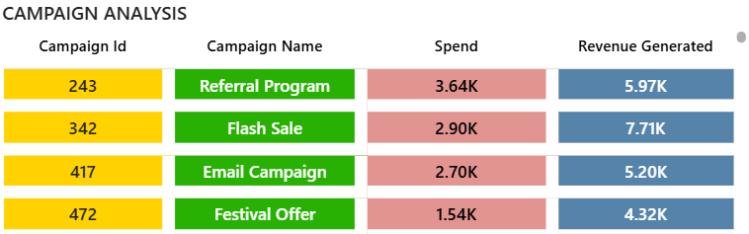
20. CAMPAIGN ANALYSIS
Purpose:
To evaluate the effectiveness of marketing campaigns based on spend and revenue.
Insights:
Flash Sale generated the highest revenue (7.71K) with moderate spend (2.90K).
Festival Offer had the best efficiency, generating 4.32K from just 1.54K spend.
All campaigns generated more revenue than their spend, indicating positive ROI.

Slide 34
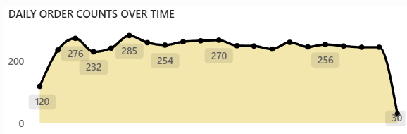
21. DAILY ORDER COUNTS OVER TIME
Purpose:
To track the fluctuation in daily order volumes.
Insights:
Orders peaked around 285, maintaining a stable trend throughout.
A sharp drop to 30 orders at the end may indicate an issue or reporting lag.

Slide 35
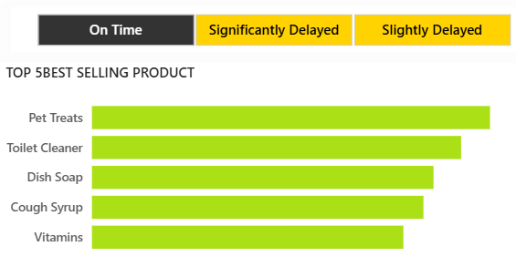
22. TOP 5 BEST SELLING PRODUCT
Purpose:
To identify the top-performing products in terms of sales volume.
Insights:
Pet Treats is the top-selling item, followed by Toilet Cleaner and Dish Soap.
All top products are fast-moving essentials or health-related.

Slide 36
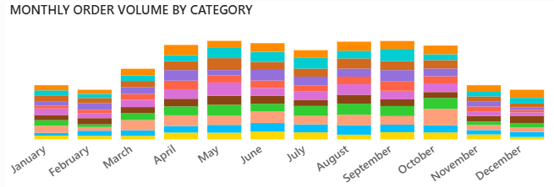
23. MONTHLY ORDER VOLUME BY CATEGORY
Purpose:
To observe order volume trends across different categories and months.
Insights:
Highest order volume observed in May and June.
Order volume is lowest during February and December, suggesting seasonal dips.

Slide 37
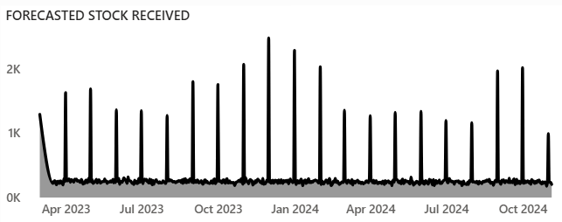
24. FORECASTED STOCK RECEIVED
Purpose:
To monitor the forecasted stock arrival pattern over time.
Insights:
Stock spikes occur periodically, showing planned bulk inflows.
Trend remains consistent till October 2024, helping in inventory planning.

Slide 38
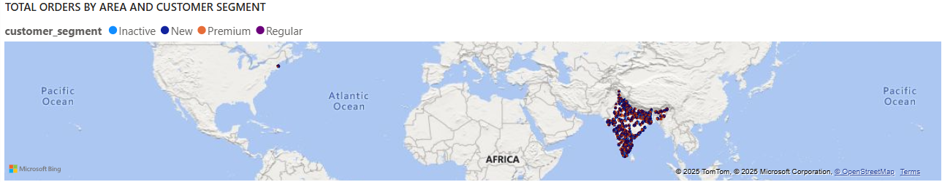
25. TOTAL ORDERS BY AREA AND CUSTOMER SEGMENT
Purpose:
To analyze geographical spread and customer segment distribution.
Insights:
Orders are heavily concentrated in India.
Majority of orders come from Regular and Premium customers.

Slide 39
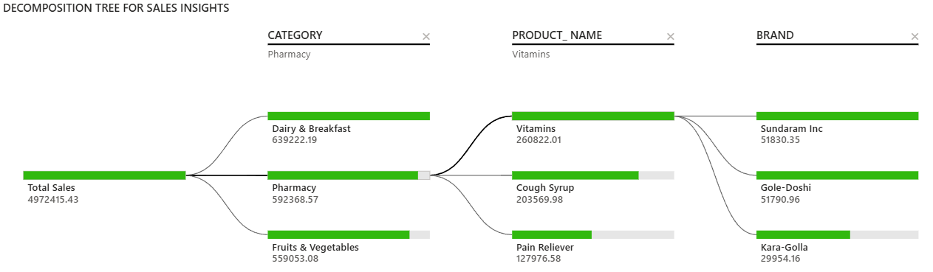
26. DECOMPOSITION TREE FOR SALES INSIGHTS
Purpose:
To explore sales distribution across categories, products, and brands.
Insights:
Total revenue is ₹49.72 L; Vitamins, Pet Treats, and Cough Syrup are top contributors.
Sundaram Inc and Gole-Doshi lead within the Pharmacy category.

Slide 40

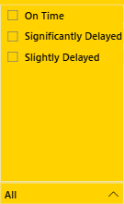
27. DELIVERY STATUS FILTER
Purpose:
To allow users to filter visuals based on delivery performance.
Insights:
Enables focused analysis of orders that are On Time, Slightly Delayed, or Significantly Delayed.
Helps identify patterns or issues specific to each delivery category.

Slide 41
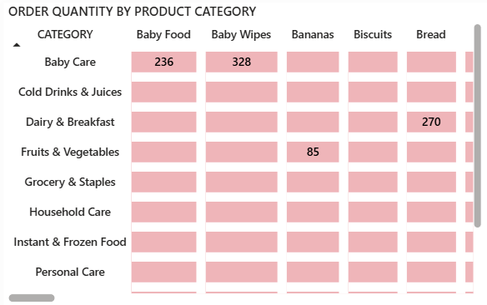
28. ORDER QUANTITY BY PRODUCT CATEGORY
Purpose:
To analyze the quantity of different products ordered across categories.
Insights:
Baby Wipes and Baby Food in Baby Care show high order volumes.
Bread in Dairy & Breakfast and Bananas in Fruits & Vegetables also have notable quantities.

Slide 42
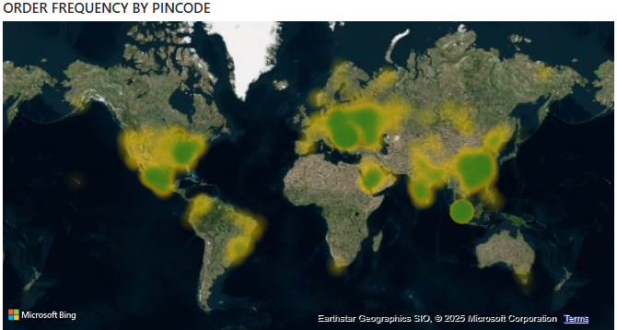
29. ORDER FREQUENCY BY PINCODE
Purpose:
To visualize geographic distribution of order frequency.
Insights:
High order concentrations are observed in India, Southeast Asia, and parts of North America.
Dense green-yellow clusters show consistent activity in urban regions.

Slide 43
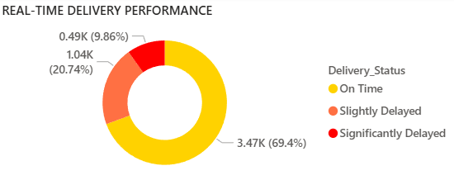
30. REAL-TIME DELIVERY PERFORMANCE
Purpose:
To track current delivery status of orders.
Insights:
69.4% of deliveries are on time.
20.74% are slightly delayed, while 9.86% are significantly delayed, indicating room for logistics improvement.

Slide 44
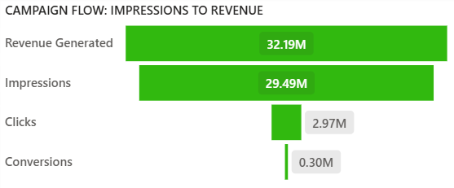
31. CAMPAIGN FLOW: IMPRESSIONS TO REVENUE
Purpose:
To measure marketing effectiveness from impressions to conversions.
Insights:
Strong conversion from impressions (29.49M) to revenue (32.19M).
Conversion drop-off is visible from clicks (2.97M) to final conversions (0.30M).

Slide 45
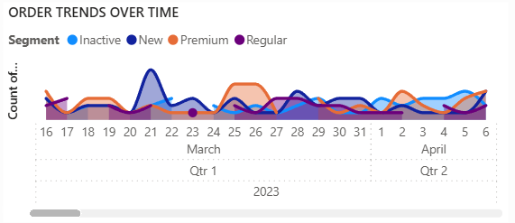
32. ORDER TRENDS OVER TIME
Purpose:
To monitor order patterns across customer segments over time.
Insights:
Premium and New users show spikes at different intervals.
Regular and Inactive segments show steady but lower engagement.

Slide 46
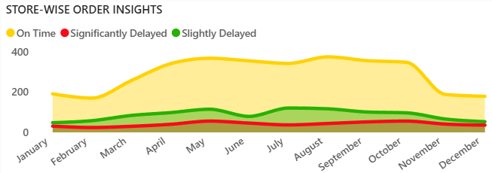
33. STORE-WISE ORDER INSIGHTS
Purpose:
To compare on-time vs. delayed deliveries by month.
Insights:
Orders peak mid-year with a consistent share of delays.
On-time deliveries dominate, but delayed orders persist throughout.

Slide 47
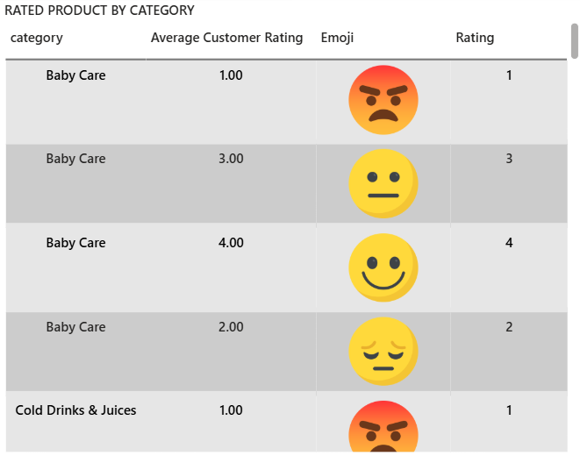
34. RATED PRODUCT BY CATEGORY
Purpose:
To display customer satisfaction by product category.
Insights:
Baby Care products show a wide spread of ratings from 1 to 4 stars.
Most ratings cluster around 2 and 3 stars, indicating mixed experiences.

Slide 48
Key Findings :
1️⃣Robust Financial Health & Customer Base:
Blinkit demonstrates strong financial performance with substantial total revenue and customer lifetime value. The customer base is well-segmented, with a healthy mix of regular, premium, and new customers.
2️⃣Seasonal Order Trends & Geographic Hotspots:
Order volumes exhibit clear seasonal peaks (e.g., May, September), and demand is concentrated in specific pincodes within Asia. This highlights opportunities for optimized logistics and targeted marketing.
3️⃣Top-Selling Products & Categories:
"Pet Treats" and household essentials like "Toilet Cleaner" are top-selling products by quantity, while "Dairy & Breakfast" is the leading revenue-generating category. This guides inventory and promotional strategies.
4️⃣Effective Marketing Campaigns & Conversion Opportunities:
"App Push Notifications" and "Category Promotions" show exceptionally high ROAS, indicating successful campaign strategies. However, the overall campaign conversion rate (0.9%) suggests room for optimizing the post-click user journey.
5️⃣Inventory Management & Quality Control Needs:
While current stock levels are healthy, high damaged stock percentages for certain perishable items (e.g., Bananas, Bread) point to a critical need for improved handling and storage protocols to reduce waste.

Slide 49
Conclusion:
This project provided invaluable experience in end-to-end data analysis using Power BI, from data cleaning and transformation to creating insightful visualizations and deriving actionable business intelligence. It deepened my understanding of e-commerce operations, customer behavior, and the critical role of data in strategic decision-making.
1️⃣Learnings:
2️⃣Decision-Making:
The analysis offers Blinkit clear, data-driven insights that can significantly aid in decision-making:
Optimizing Marketing Spend: By identifying high-ROAS campaigns, Blinkit can reallocate budgets to maximize returns.
Improving Inventory Management: Insights into top-selling products, category revenue, and damaged stock percentages enable more efficient stocking and reduced waste.
Enhancing Customer Experience: Understanding customer segments, order patterns, and feedback details can lead to more personalized services and targeted improvements.
Strategic Expansion: Geographic order data can guide decisions on where to expand operations or focus delivery network enhancements.
Operational Efficiency: Analysis of delivery times and store performance can pinpoint areas for logistical improvements.

Slide 50
REFERENCES:
1️⃣Dataset Source:
Kaggle - https://www.kaggle.com/datasets/akxiit/blinkit-sales-dataset/data
2️⃣Tools Documentation:
Power BI Documentation
GitHub Documentation

Slide 51
GITHUB REPOSITORY LINK :
You can find the Power BI report, dataset, and all related project files at the following GitHub repository:
🔗 https://github.com/payal-kangsabanik/POWER_BI-

Slide 52
THANK YOU!!

